Slide 1
Chapter 7: Normalization

Slide 2
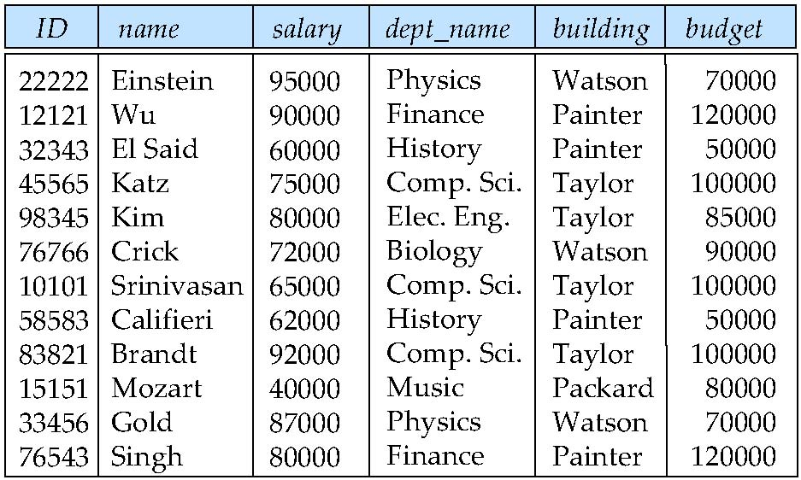
Decomposition
The only way to avoid the repetition-of-information problem is to decompose it into two schemas. However, not all decompositions are good. Suppose we decompose
employee(ID, name, street, city, salary)
into
employee1 (ID, name)
employee2 (name, street, city, salary)
The problem arises when we have two employees with the same name. This can result in a lossy decomposition, i.e., we cannot reconstruct the original employee relation from employee1 and employee 2.
in_dep: repetition-of-information

Slide 3
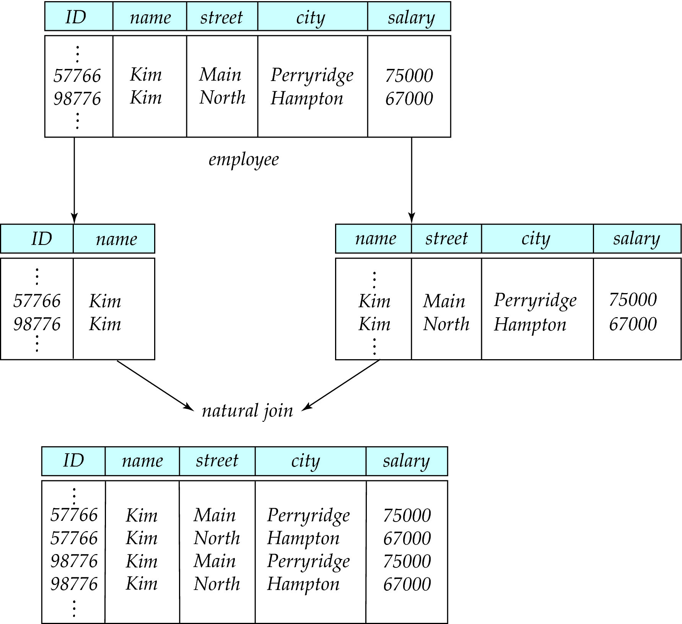
A Lossy Decomposition

Slide 4
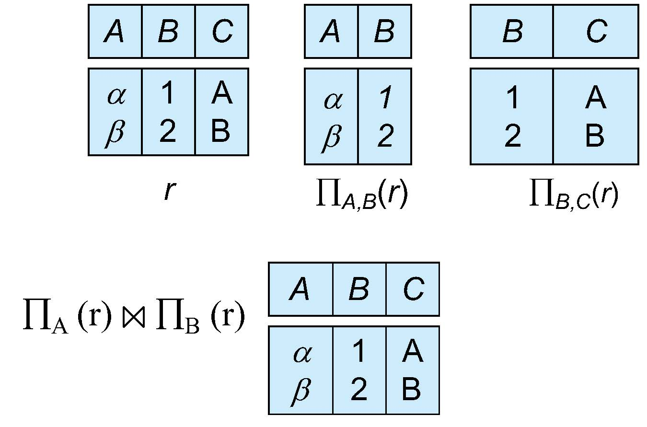

Lossless Decomposition
Let R be a relation schema and let R₁ and R₂ form a decomposition of R . That is R = R₁ U R₂
We say that the decomposition is a lossless decomposition if there is no loss of information by replacing R with the two relation schemas R₁ U R₂
Formally,
∏ _{R1} (r) ∏ _{R2} (r) = r
Decomposition of R = (A, B, C): R₁ = (A, B), R₂ = (B, C)

Slide 5
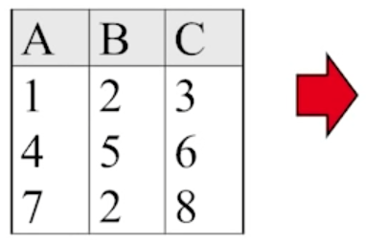
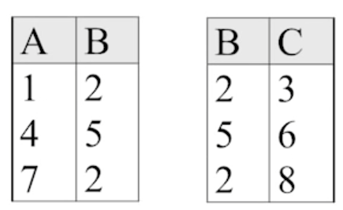
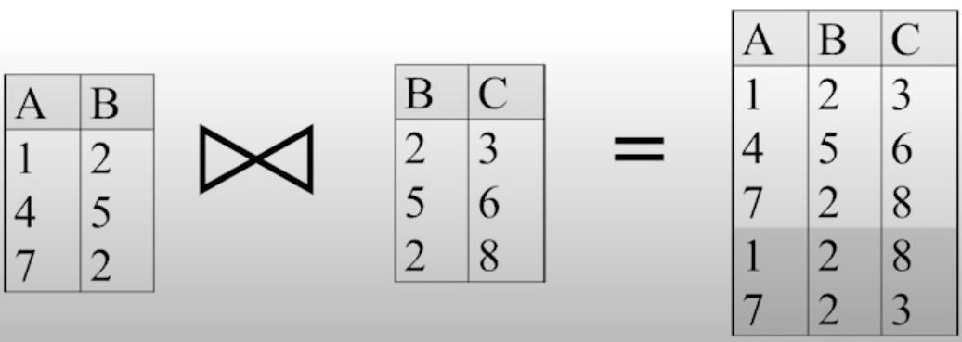
Lossless Decomposition
Try: Is this a lossless decomposition?
Ans: No. ∏ _{R1} (r) ∏ _{R2} (r) ≠ r
Lecture 17 Part 6 Lossless Join Decompositions (youtube.com)

Slide 6
Normalization Theory
Decide whether a particular relation R is in “good” form.
In the case that a relation R is not in “good” form, decompose it into set of relations {R₁, R₂, ..., R_{n}} such that
Each relation is in good form
The decomposition is a lossless decomposition
Our theory is based on:
Functional dependencies
Multivalued dependencies

Slide 7
Functional Dependencies Definition
Let R be a relation schema
α ⊆ R and β ⊆ R
The functional dependency
α → β
holds on R if and only if for any legal relations r(R), whenever any two tuples t₁ and t₂ of r agree on the attributes α, they also agree on the attributes β. That is,
t₁[α] = t₂ [α] ⇒ t₁[β ] = t₂ [β ]
Consider the in_dep example just now:
in_dep (ID, name, salary, dept_name, building, budget ).
We expect these functional dependencies to hold:
dept_name→ building
ID → building
but would not expect the following to hold:
dept_name → salary

Slide 8
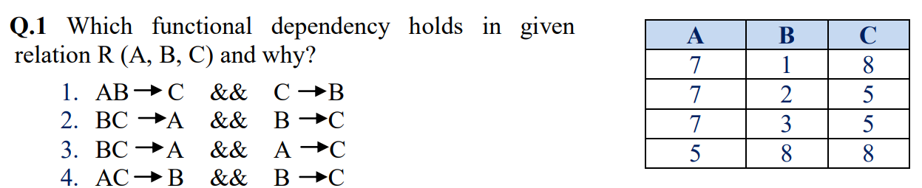
Functional Dependencies
Try:
Alevel_1_DBMS_21Apr2020_AV.pdf (nielit.gov.in)

Slide 9
Lossless Decomposition
We can use functional dependencies to show when certain decomposition are lossless.
For the case of R = (R₁, R₂), we require that for all possible relations r on schema R
r = ∏_{R1} (r ) ∏_{R2} (r )
A decomposition of R into R₁ and R₂ is lossless decomposition if at least one of the following dependencies is in F⁺:
R₁ ∩ R₂ → R₁
R₁ ∩ R₂ → R₂
Example: R = (A, B, C), F = {A → B, B → C)
R₁ = (A, B), R₂ = (B, C)
This is a lossless decomposition:
R₁ ∩ R₂ = {B} and B → BC
Try: R₁ = (A, B), R₂ = (A, C)
This is a lossless decomposition:
R₁ ∩ R₂ = {A} and A → AB

Slide 10
Boyce-Codd Normal Form
A relation schema R is in BCNF with respect to a set F of functional dependencies if for all functional dependencies in F⁺ of the form
α → β
where α ⊆ R and β ⊆ R, at least one of the following holds:
α → β is trivial (i.e., β ⊆ α)
α is a superkey for R
Example schema that is not in BCNF:
in_dep (ID, name, salary, dept_name, building, budget )
because :
dept_name→ building, budget is a functional dependency but
dept_name is not a superkey

Slide 11

Boyce-Codd Normal Form
A relation schema R is in BCNF with respect to a set F of functional dependencies if for all functional dependencies in F⁺ of the form α → β where α ⊆ R and β ⊆ R, at least one of the following holds:
α → β is trivial (i.e., β ⊆ α)
α is a superkey for R
Try: Is this relation schema in BCNF?
Boyce-Codd Normal Form (BCNF) - GeeksforGeeks

Slide 12
Boyce-Codd Normal Form
Some functional dependencies include:
Stu_ID −> Stu_Branch
Stu_Course −> {Branch_Number, Stu_Course_No}
For both functional dependencies α → β above, α is not a superkey for R
The candidate key is {Stu_ID, Stu_Course}
So, the schema is not in BCNF.

Slide 13
Third Normal Form
Third Normal Form is a minimal relaxation of BCNF to ensure dependency preservation.
A relation schema R is in third normal form (3NF) if for all:
α → β in F⁺
at least one of the following holds:
α → β is trivial (i.e., β ∈ α)
α is a superkey for R
Each attribute A in β – α is contained in a candidate key for R.
(NOTE: each attribute may be in a different candidate key)
If a relation is in BCNF it is in 3NF (since in BCNF one of the first two conditions above must hold).

Slide 14
Closure of a Set of Functional Dependencies
The set of all functional dependencies logically implied by F is the closure of F, denoted by F⁺.
We can compute F⁺, the closure of F, by repeatedly applying Armstrong’s Axioms:
Reflexive rule: if β ⊆ α, then α → β
Augmentation rule: if α → β, then γ α → γ β
Transitivity rule: if α → β, and β → γ, then α → γ
Additional rules:
Union rule: If α → β holds and α → γ holds, then α → β γ holds.
Decomposition rule: If α → β γ holds, then α → β holds and α → γ holds.

Slide 15
Closure of Attribute Set
Given a set of attributes α, define the closure of α under F (denoted by α⁺) as the set of attributes that are functionally determined by α under F
Example: R = (A, B, C, G, H, I)
F = {A → B A → C CG → H CG → I B → H}
Find the closure of {AG}. That is, C(AG)⁺:
1. result = AG
2. result = ABCG (A → C and A → B)
3. result = ABCGH (CG ⊆ AGBC and CG → H)
4. result = ABCGHI (CG ⊆ AGBCH and CG → I)
Important use: testing functional dependencies
To check if a functional dependency α → β holds (or, in other words, is in F⁺), just check if β ⊆ α⁺.
That is, we compute α⁺ by using attribute closure, and then check if it contains β.

Slide 16
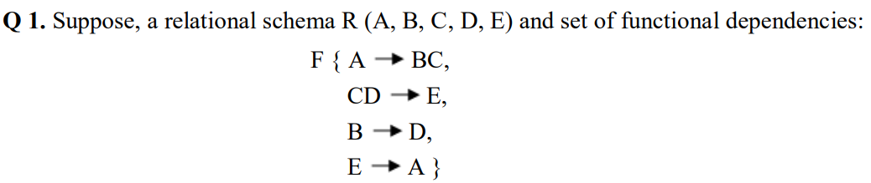
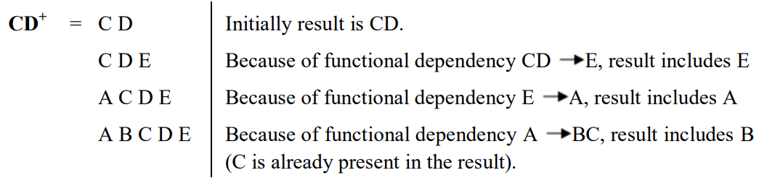
Closure of Attribute Set
Try:
Compute CD⁺.
Alevel_1_DBMS_27Apr2020_AV.pdf (nielit.gov.in)

Slide 17



Testing if an Attribute is Extraneous
An attribute of a functional dependency in F is extraneous if we can remove it without changing F ⁺
Consider an attribute in the functional dependency α → β.
To test if attribute A ∈ β is extraneous in β
Consider the set: F' = (F – {α → β}) ∪ {α →(β – A)}
Check that α⁺ under F' contains A; if it does, A is extraneous in β
Try: Let F = {AB → CD, A → E, E → C }. Check if C is extraneous in AB → CD:
Compute the attribute closure of AB under F' = {AB → D, A → E, E → C}
The closure is ABCDE, which includes C. So, C is extraneous.
To test if attribute A ∈ α is extraneous in α
Let γ = α – {A}. Check if γ → β can be inferred from F.
Compute γ⁺ using the dependencies in F
If γ⁺ includes all attributes in β then A is extraneous in α
This is just removing A from the right side
$$A$$
$$α$$
$$β$$

Slide 18
Canonical Cover
If an update violates any functional dependencies in the set F, the system must roll back the update.
We can reduce the effort spent in checking for violations by testing a simplified set of functional dependencies that has the same closure as the given set.
This simplified set is termed the canonical cover.
A canonical cover for F is a set of dependencies F_{c} such that
F logically implies all dependencies in F_{c} , and
F_{c} logically implies all dependencies in F, and
No functional dependency in F_{c} contains an extraneous attribute, and
Each left side of functional dependency in F_{c} is unique. That is, there are no two dependencies in F_{c}
α₁ → β₁ and α₂ → β₂ such that
α₁ = α₂

Slide 19
Canonical Cover
To compute a canonical cover for F:
repeat
Use the union rule to replace any dependencies in F of the form
α₁ → β₁ and α₁ → β₂ with α₁ → β₁ β₂
Find a functional dependency α → β in F_{c} with an extraneous
attribute either in α or in β
/* Note: test for extraneous attributes done using F_{c,} not F*/
If an extraneous attribute is found, delete it from α → β
until (F_{c} not change
Note: Union rule may become applicable after some extraneous attributes have been deleted, so it has to be re-applied
Try: Find the canonical cover for
R = (A, B, C) F = {A → BC B → C A → B AB → C}

Slide 20
Example: Computing a Canonical Cover
R = (A, B, C) F = {A → BC B → C A → B AB → C}
Combine A → BC and A → B into A → BC
Set is now {A → BC, B → C, AB → C}
A is extraneous in AB → C
Check if the result of deleting A from AB → C is implied by the other dependencies
Yes: in fact, B → C is already present!
Set is now {A → BC, B → C}
C is extraneous in A → BC
Check if A → C is logically implied by A → B and the other dependencies
Yes: using transitivity on A → B and B → C.
Can use attribute closure of A in more complex cases
The canonical cover is: A → B B → C
union rule: replace α₁ → β₁ and α₁ → β₂ with α₁ → β₁ β₂
To test if attribute A ∈ α is extraneous in α:
Let γ = α – {A}. Check if γ → β can be inferred from F.

Slide 21
Dependency Preservation
Let F_{i} be the set of dependencies F ⁺ that include only attributes in R_{i}.
A decomposition is dependency preserving, if
(F₁ ∪ F₂ ∪ … ∪ F_{n} )⁺ = F ⁺
If a decomposition is NOT dependency preserving then checking updates for violation of functional dependencies may require computing joins, which is expensive.
Example: Decompose R(A, B, C, D) under F = {A → B, B → C} into
R₁(AB), R₂(AC), R₃(AD),
Is this decomposition dependency preserving?
(F₁ ∪ F₂ ∪ F₃ )⁺ = {A → B, A → C, (omitting trivial FDs)}
(F₁ ∪ F₂ ∪ F₃ )⁺ ≠ F⁺
Therefore, this decomposition is not dependency preserving.

Slide 22
Dependency Preservation
Try: Decompose R(A, B, C, D, E, F, G, H) under
F = {AB → E, C → D, D → E, FG → A} into
R₁(ABE), R₂(CD), R₃(FGA), R₄(BCFGH)
Is this decomposition dependency preserving?
F₁ = {AB → E}
F₂ = {C → D}
F₃ = {FG → A}
F₄ = { }
{D → E} is lost. Therefore, (F₁ ∪ F₂ ∪ F₃ ∪ F₄ )⁺ ≠ F^{+.}
This decomposition is not dependency preserving.
Computer Science and Engineering - Tutorials, Notes, MCQs, Questions and Answers: Normalization MCQ with answers in DBMS 19 (exploredatabase.com)

